Slide 1
AI-Driven Crop Disease Prediction and Management System
CSE7101- Capstone Project
Review-1
Batch Number: ISE_23
Roll Number | Student Name
20221ISE0077 | HARSHITHA V
20221ISE0085 | TAANYA SUBBAIAH B
20221ISE0065 | M ASWIN
Under the Supervision of,
Dr. Murali Parameswaran
Professor
School of Computer Science and Engineering
Presidency University
Name of the Program: Information Science and Engineering
Name of the HoD: Dr. Zafar Ali Khan N
Name of the Program Project Coordinator: Ms. Suma N G
Name of the School Project Coordinators: Dr. Sampath A K , Dr. Geetha A

Slide 2
Problem Statement Number: PSCS_282
Organization: Agriculture, FoodTech and Rural Development
Category(Hardware / Software / Both) : Software
Problem Description: Crop diseases cause major losses to farmers because they are hard to identify early and often require expert knowledge. Existing methods are slow and inaccurate, so we need an AI-based system that can quickly detect diseases from crop images and give farmers instant management advice.

Slide 3
Content:
Problem Statement
Objectives
Background and Related work for title Selection
Analysis of Problem Statement
Innovation or Novel Contributions
Git-hub Link
Timeline of the Project
References

Slide 4
Problem Statement & Objectives:
Problem Statement: Crop diseases reduce yield and cause financial loss. Farmers rely on slow and inaccurate manual inspection, and existing tools only detect diseases without giving proper solutions. A simple AI-based system is needed to quickly detect diseases and guide farmers with management advice.
Objectives:
Detect crop diseases from images using AI.
Provide instant diagnosis and details.
Suggest treatment and preventive measures.
Develop a simple and farmer-friendly app.

Slide 5
Background and Related work:
Farmers usually identify diseases by visual/manual inspection, which is often inaccurate.
Research datasets have enabled AI training for crop disease detection.
CNN-based models like ResNet, MobileNet and EfficientNet have shown high accuracy in experiments.
Existing apps/tools mostly focus only on detection without offering management support.

Slide 6
Analysis of Problem Statement:
Agriculture is vital for food security and economy.
Crop losses impact farmer livelihood and productivity.
Misidentification delays treatment and reduces yield.
Farmers face knowledge and technology limitations.
AI can provide low-cost, reliable disease support.
A complete solution must cover both detection & management.
Inputs: Leaf images, environmental data (humidity, temperature, rainfall).
Outputs: Disease classification, severity prediction, and treatment recommendations.
Challenges:
Variability in leaf images (light, angle, background).
Need for lightweight models for mobile deployment.
Providing accurate management suggestions, not just detection.

Slide 7
Technology Stack and Requirements
Software Requirements:
Programming Language: Python (model)
Frameworks: TensorFlow / PyTorch
Libraries: OpenCV, NumPy, Pandas, Matplotlib, Scikit-learn
Version Control: GitHub
Hardware Requirements:
Min 8GB RAM, GPU for training.
Smartphones with camera for farmer use.
Internet connectivity for cloud access.

Slide 8
Innovation or Novel Contributions:
Combines disease detection and management advice.
Uses deep learning like CNN/transfer learning for accuracy.
Optimized lightweight models for mobile usage.
Provides preventive measures, not just cures.
User-friendly interface for non-technical farmers.
Open-source design for scalability and upgrades.

Slide 9
GitHub Link:
The Github link is provided with public access permission.
GitHub Link:
AI-driven-Crop-Disease-Prediction-and-Management-System

Slide 10
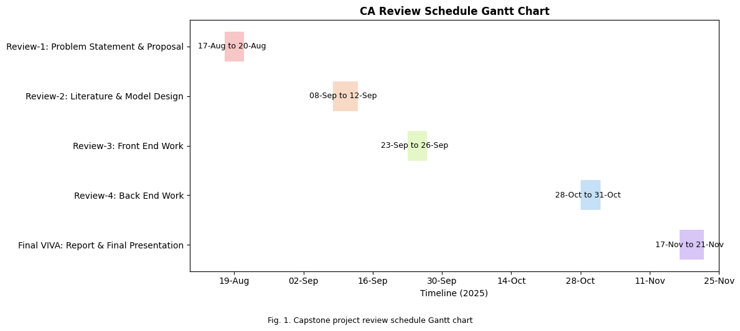
Timeline of the Project (Gantt Chart)

Slide 11
References (IEEE Paper format)
[1]. A. Kumar, B. R. Patel, and C. Zhang, “Plant disease identification using convolutional neural networks,” IEEE Access, vol. 9, pp. 34567–34578, Mar. 2021.
[2]. J. Smith, “Deep learning in agricultural systems,” IEEE Transactions on Neural Networks and Learning Systems, vol. 32, no. 7, pp. 1234–1245, Jul. 2021.
[3]. S. Mohanty, D. Hughes, and M. Salathé, “Using deep learning for image-based plant disease detection,” Frontiers in Plant Science, vol. 7, p. 1419, Sep. 2016.
[4]. A. Too, L. Yujian, S. Njuki, and L. Yingchun, “A comparative study of fine-tuning deep learning models for plant disease identification,” Computers and Electronics in Agriculture, vol. 161, pp. 272–279, Jun. 2019.
[5]. P. Ferentinos, “Deep learning models for plant disease detection and diagnosis,” Computers and Electronics in Agriculture, vol. 145, pp. 311–318, Feb. 2018.

Slide 12


